Slide 1
Welcome
To
Project - 2
Web Scraping &
Word Frequency
Name – Mohd Jubair Khan
Date – 14 – 02 - 2024

Slide 2
Abstract
In this project we will do Web Scraping & Word Frequency.
Web Scraping, also known as web harvesting or web data extraction, is a type of data scraping used to gather information from websites . It allows you to retrieve information from a website that you can’t access through an API or other means. Python provides several libraries that make web scraping easier. Beautiful Soup is used to extract information from HTML and XML files. Split the string into a list of words.
Use set() to get a unique set of words . Use a list comprehension to count the frequency of each word in the original list.

Slide 3
Content
1. Introduction
2. Objectives
3. Methods
4. Results
5. Conclusions
Chapter - 1
1. Introduction
In this project we will do Web Scrapping & word Frequency. Web scrapping is the term for using a program to download and process content the web. In this project we will use two essential libraries Requests & BeautifulSoup.

Slide 4
Chapter - 2
2. Objectives:
(i). Web Scraping
Web Scraping, also known as web harvesting or web data extraction, is a type of data scraping used to gather information from websites. It allows you to retrieve information from a website that you can’t access through an API or other means. Python provides several libraries that make web scraping easier.
Task 1: Web Scraping: Use libraries like requests and BeautifulSoup to scrape
data from a website [Welcome to Python. org]

Slide 5
(ii). Word Frequency
Step-by-step approach:
Split the string into a list of words.
Use set() to get a unique set of words.
Use a list comprehension to count the frequency of each word in the original list.
Store the results in a dictionary using dictionary comprehension.
Print the final result.
Task 2: Word Frequency Create a program that reads a created text file from
task 1 and counts the frequency of each word.

Slide 6
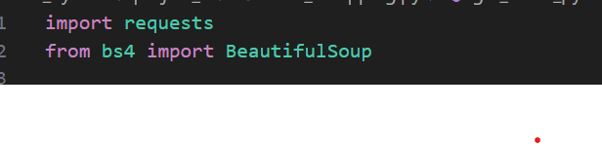
Chapter - 3
3. Methods
(a). Import Libraries
Use libraries like requests and BeautifulSoup to scrape data from a website.
(b). Web Scraping module
The web browser module has some built in functionality to aid us in the web scraping process.

Slide 7
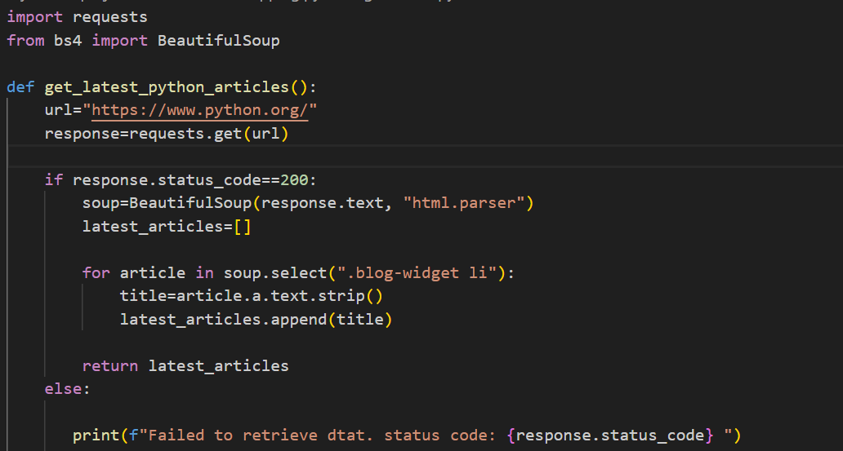
Web Browser: - Comes with python and open a browser to a python page.
Requests:- Downloads latest News articles from python page .
Beautiful Soup:- Parser HTML

Slide 8
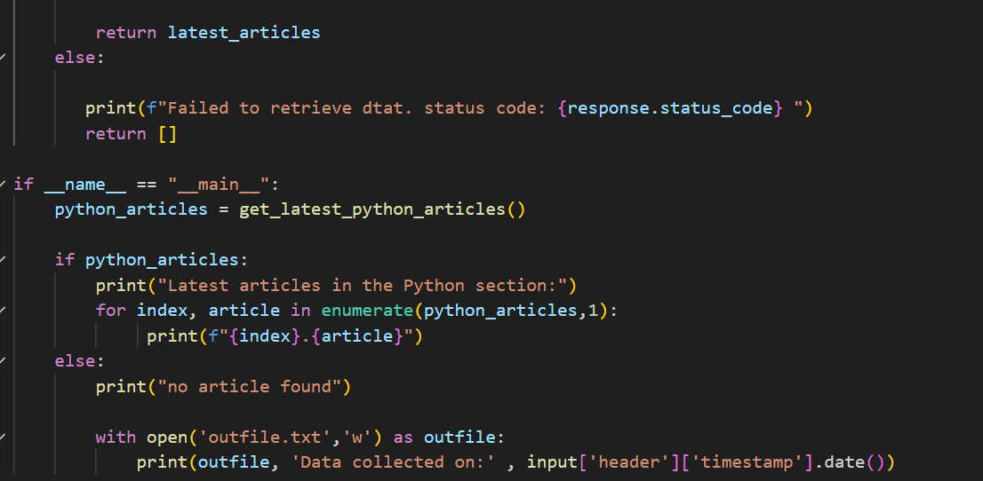
Word Frequency:
Split the string into a list of words.
Use set() to get a unique set of words.
Use a list comprehension to count the frequency of each word in the original list.
Store the results in a dictionary using dictionary comprehension.
Print the final result.

Slide 9
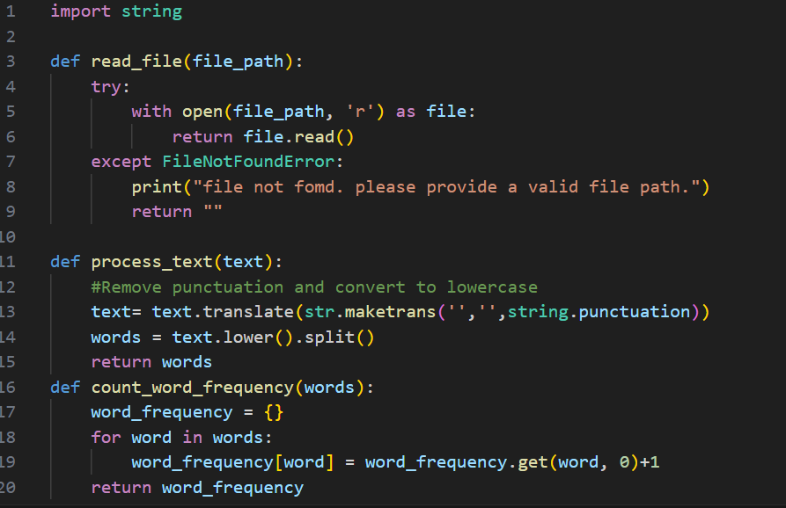
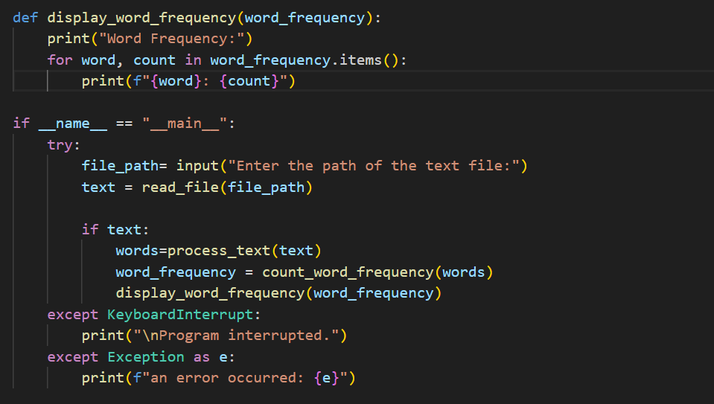

Slide 10
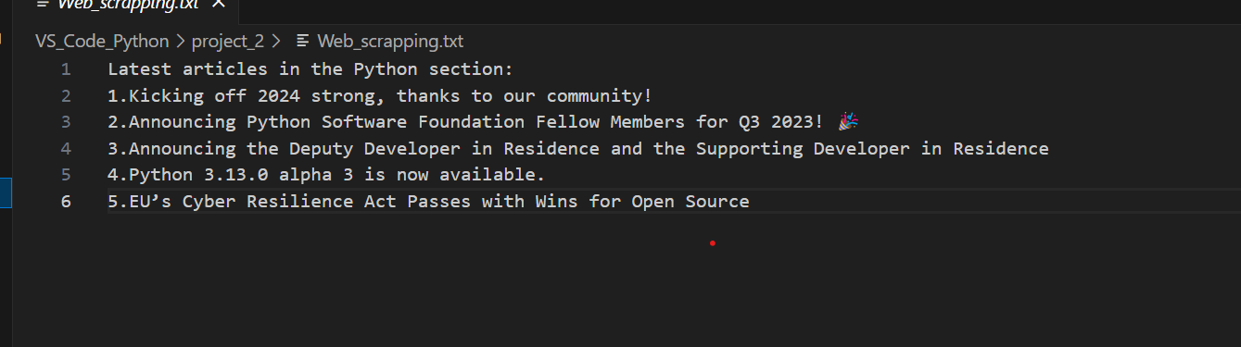
Chapter - 4
4. Results:
After adding libraries in this project, I took the URL of python site and added it to my beautiful soup library. Or after that I get the latest news articles from the python site. Or saved it in a text file.

Slide 11
Chapter - 5
5. Conclusions:
We have explored the ultimate guide to web scraping with Python, uncovering the ins and outs of this powerful technique. We’ve covered the essentials, from understanding web scraping and its various use cases to delving into why Python is the preferred language for scraping projects. In this code-along tutorial, we have covered the basics of word frequency analysis, including acquiring a text, performing tokenization, removing punctuations and stopwords.

